Slide 1

VA Digital Modernization Council
October 19, 2022

Slide 2
Agenda
VA Digital Modernization Council Meeting
CTO Welcome | 5 min
Homepage Refresh | 15 min
Omnichannel Strategy | 15 min

Slide 3
CTO Welcome

Slide 4
Homepage Refresh
Presenters:
Dave Conlon
Ryan Thurlwell
Michelle Middaugh

Slide 5
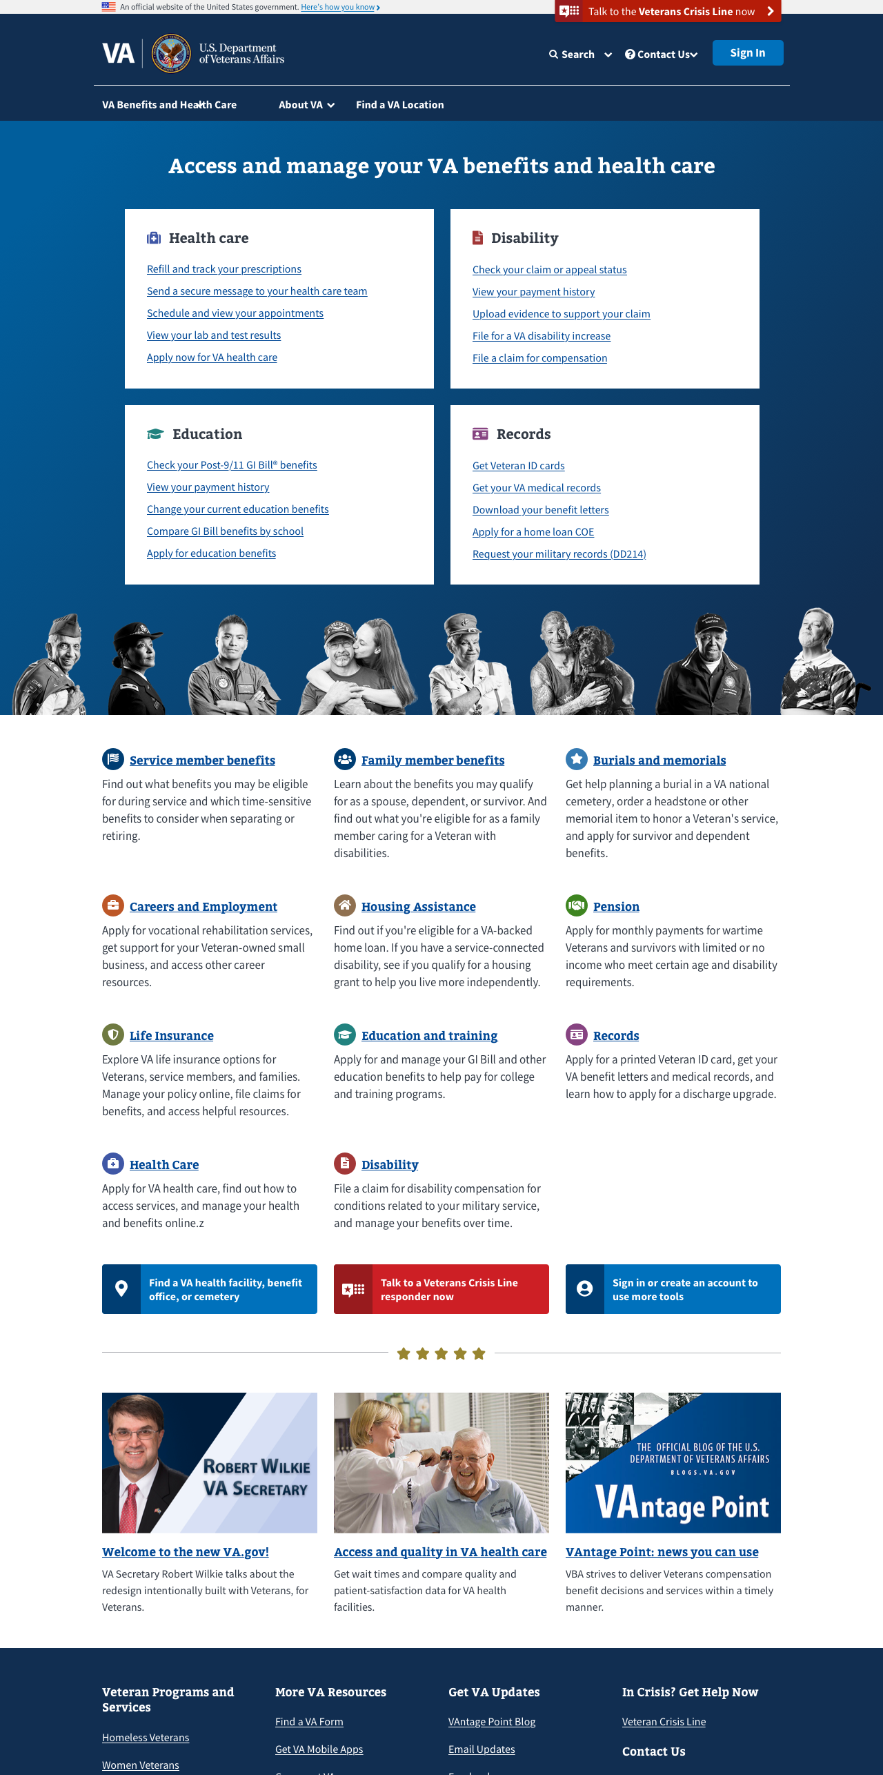
2018 Homepage goals
Helping Veterans and beneficiaries….
Homepage Refresh - Background
complete tasks to manage their benefits and services
The VA homepage was launched in 2018. Since the initial launch, we have continued making improvements in alignment with the following digital modernization goals:
increase the use of VA’s self-service tools
enable faster access to care and more timely delivery of services
improve the experience our users have when interacting with the VA
explore VA benefits and services
log in for access to a personalized, streamlined experience
get the latest information
5
Notes:
Part of the web brand consolidation exercise – problems to solve: not presenting veteran-focused

Slide 6
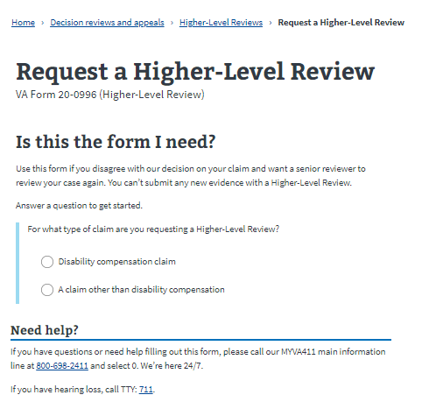
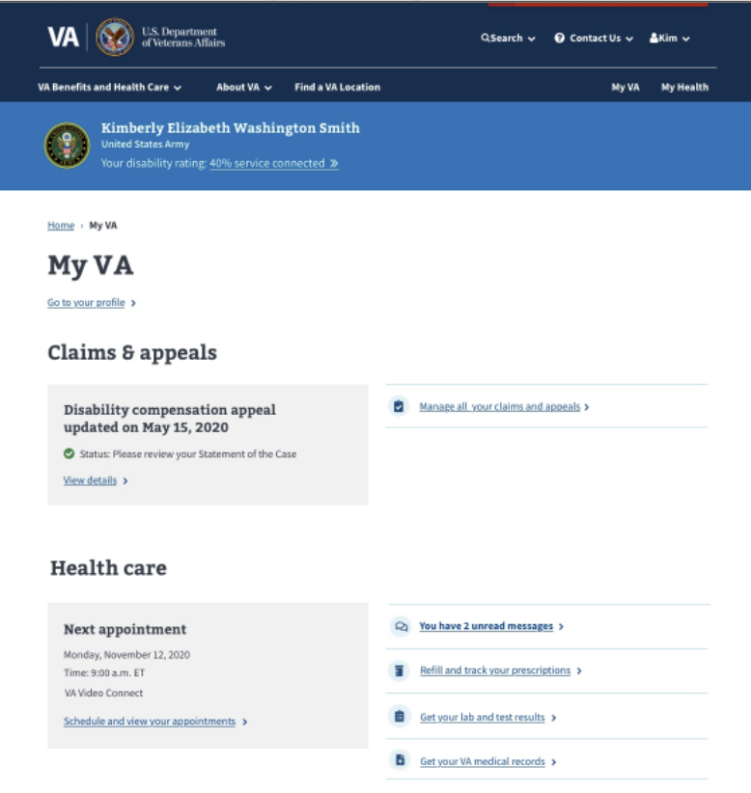
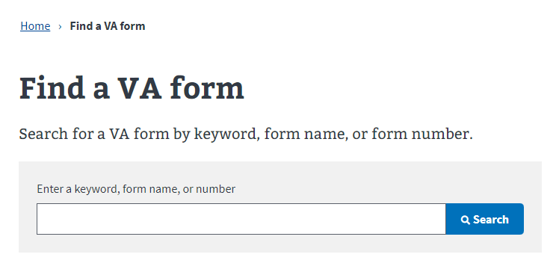
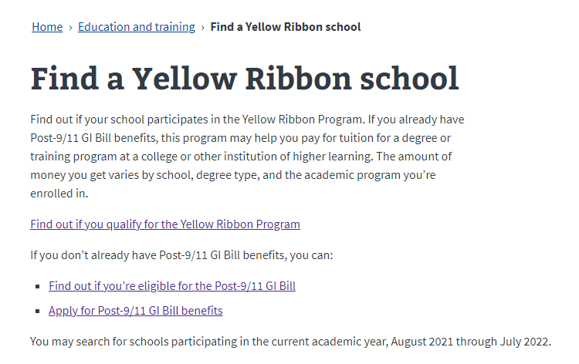
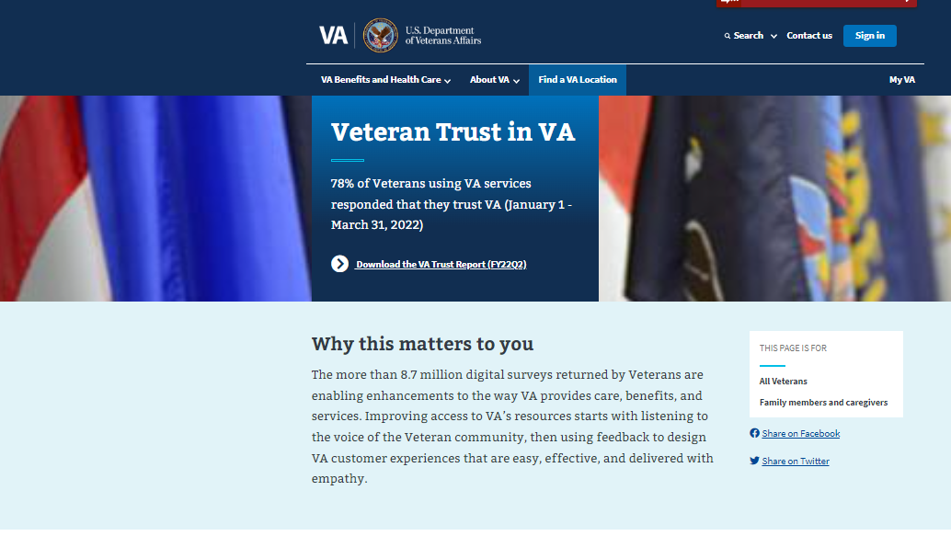
VA.gov evolution since 2018
Homepage Refresh - Background
The landscape of available VA benefits and programs has expanded and evolved since launch in 2018.
Veterans have evolved, too. They are now beginning to understand the benefits of logging in. The VA.gov homepage should reflect the evolution of our Veterans and their needs.
Notes:
Nothing is perfect and we’re always looking at analytics and listening to Veterans to understand how we can better serve their needs.

Slide 7
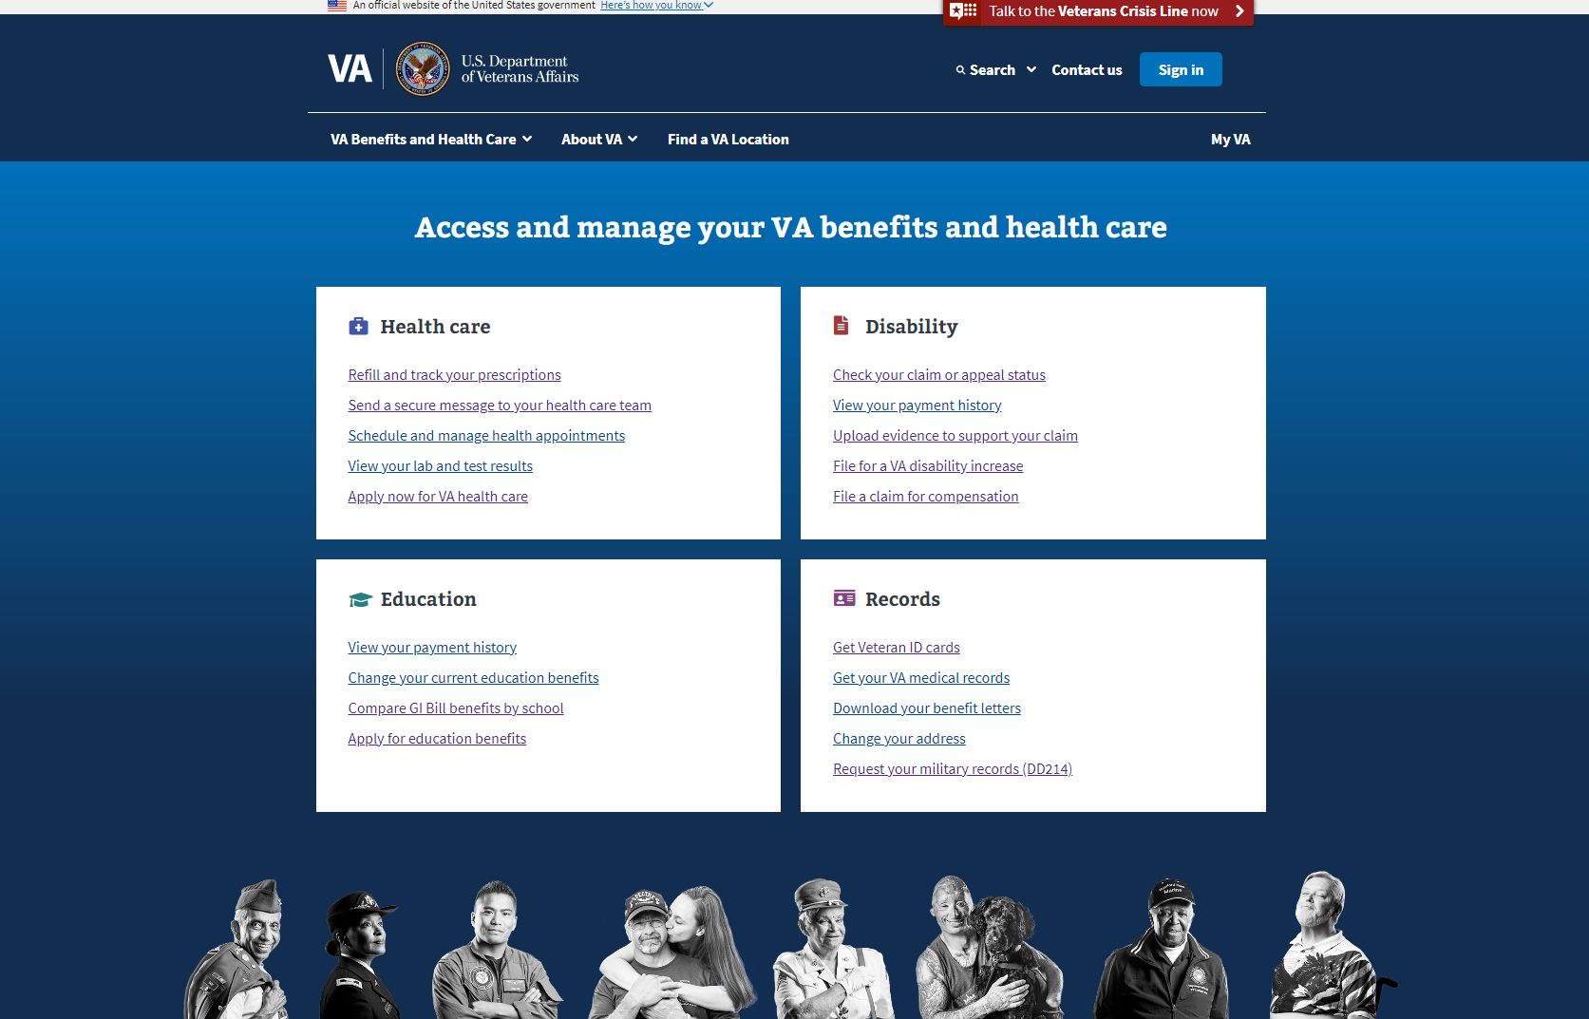
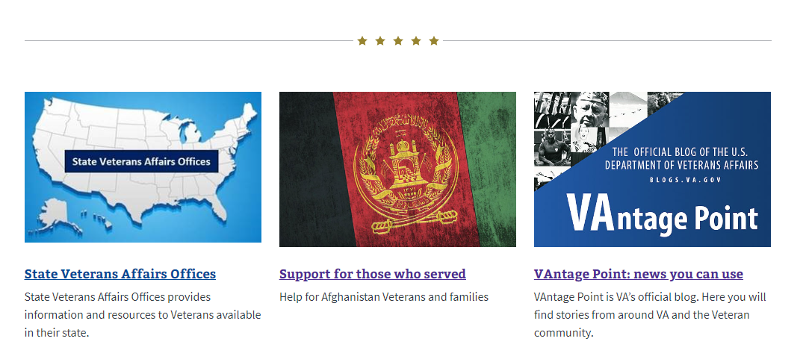
Veteran use of the homepage
Homepage Refresh - Background
Veterans tend to focus on a single area of the homepage, usually the top four boxes.
There is lower engagement with content below the portraits, serving as a “false bottom.”
Notes:
High cognitive load and the false bottom created by the row of Veteran portraits means Veterans rarely scroll the full page, making some tasks harder to complete than others and negatively affecting engagement with content lower on the page.

Slide 8
Task completion
Homepage Refresh - Background
A few tasks get most of the traffic:
Refill and track your prescriptions
Check your claim or appeal status
View your payment history
Download your benefit letters
Despite this task-heavy design, some tasks are still difficult to complete.
Notes:
High cognitive load and the false bottom created by the row of Veteran portraits means Veterans rarely scroll the full page, making some tasks harder to complete than others and negatively affecting engagement with content lower on the page.

Slide 9
Organizational needs
Homepage Refresh - Background
The current design doesn’t meet organizational needs, such as
helping Veterans discover changes at the VA, including products, services or eligibility, that affect them so that they can act
promoting avenues that empower Veterans to receive information rather than actively seek it out
directing non-Veteran/beneficiary audiences where to go for information and tasks appropriate to their needs (e.g., department.va.gov)
prominence and discoverability of important content

Slide 10
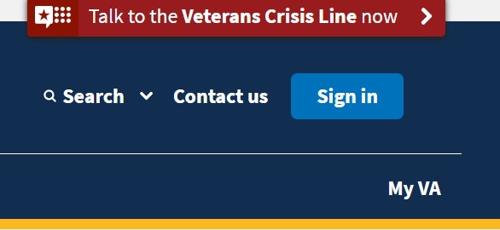
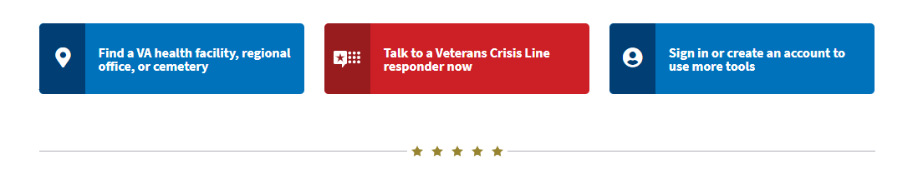
Search and sign-in metrics
Homepage Refresh - Objectives
There were ~586K unique searches initiated from the homepage (Jan-Jun 2022)
This accounts for ~12% of total unique searches across VA.gov
~15% of visitors to VA.gov log in to complete a variety of tasks

Slide 11
Opportunities
Homepage Refresh - Objectives
Make it easier for Veterans to navigate the page, engage with relevant information, and complete their tasks
Clearly define content purposes to optimize the space
Encourage use of the logged in experience
Improve the discoverability and findability of information
Provide an avenue for Veterans to receive updates and information by making a sign-up available
Improve accessibility and equity for all users including rural, low-bandwidth
Notes:
The homepage is for everyone so we need to ensure that everyone can access it, regardless of bandwidth, rural connectivity, assistive technology

Slide 12
Veteran-focused design approach
Homepage Refresh - Approach
As a modernized product, we use human-centered design and feedback from Veterans.
We continue to use findings from Veteran research, quantitative user data, and benefit utilization to validate design hypotheses and shape the evolution of the homepage.
We don't expect every hypothesis to be correct or every experiment to be 100% successful.
*This iteration of the VA.gov homepage refresh does not include changes to the header, megamenu, footer, alerts or banners.

Slide 13
Design Experiment v1

Slide 14
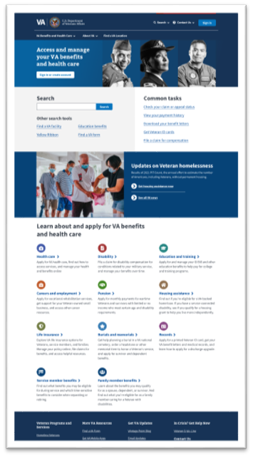
Features
Homepage Refresh – Design Experiment v1
We experimented with the design and conducted Veteran research to validate our first hypotheses, which included
The Common task list was influenced by Veteran research into their most important tasks.
a more readily available login would increase use of the logged in experience
a more prominent search feature would intuitively empower Veterans to find and complete less common tasks
a focused and prominently displayed Vantage Point blog promo increases participants' engagement with the content
14

Slide 15
Takeaways
Homepage Refresh – Design Experiment v1
We conducted Veteran research using the design to validate our hypotheses and iterated on the design, based on our findings, which included
Veterans and beneficiaries tend to navigate the homepage using the method which works for them, which could be the megamenu in the header, task links, benefit hubs, searching, or some combination
Link labels and other content must be clear and meaningful
The presence of duplicate sign-in buttons causes confusion
They need context to distinguish between news stories, ads, and information about benefit changes
They often sign in from a specific task-related content page

Slide 16
Design Experiment v2

Slide 17
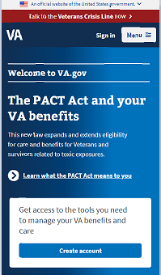
Meaningful content and account support
Homepage Refresh – Design Experiment v2
this prominent area is designed to feature fresh content, updated on a regular basis to maintain engagement with homepage spotlights
Visible CTA for account creation, separate from sign-in
17

Slide 18
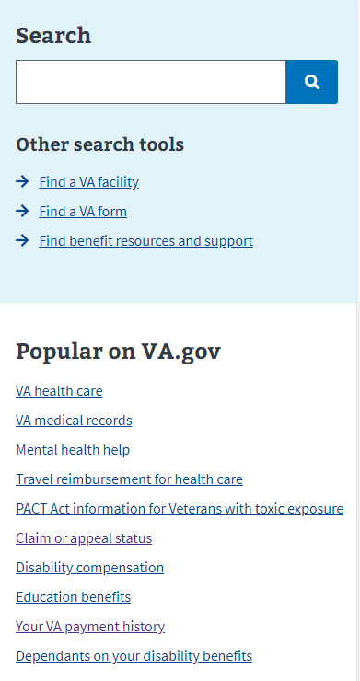
Support for task completion
Homepage Refresh – Design Experiment v2
Access to search and search tools
Optimized list of popular links defined by analytics on page use, searches initiated from the home page, and benefit utilization
18

Slide 19
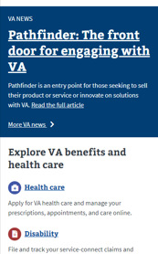
Access to VA News
Homepage Refresh – Design Experiment v2
VA News story spotlight
Access to full VA News site
Notes:
Potential for future automation

Slide 20
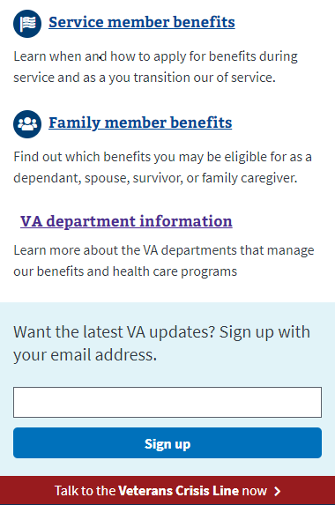
New elements
Homepage Refresh – Design Experiment v2
Support for non-Veteran and beneficiary audiences
Empowering Veterans to receive information rather than actively seek it out

Slide 21
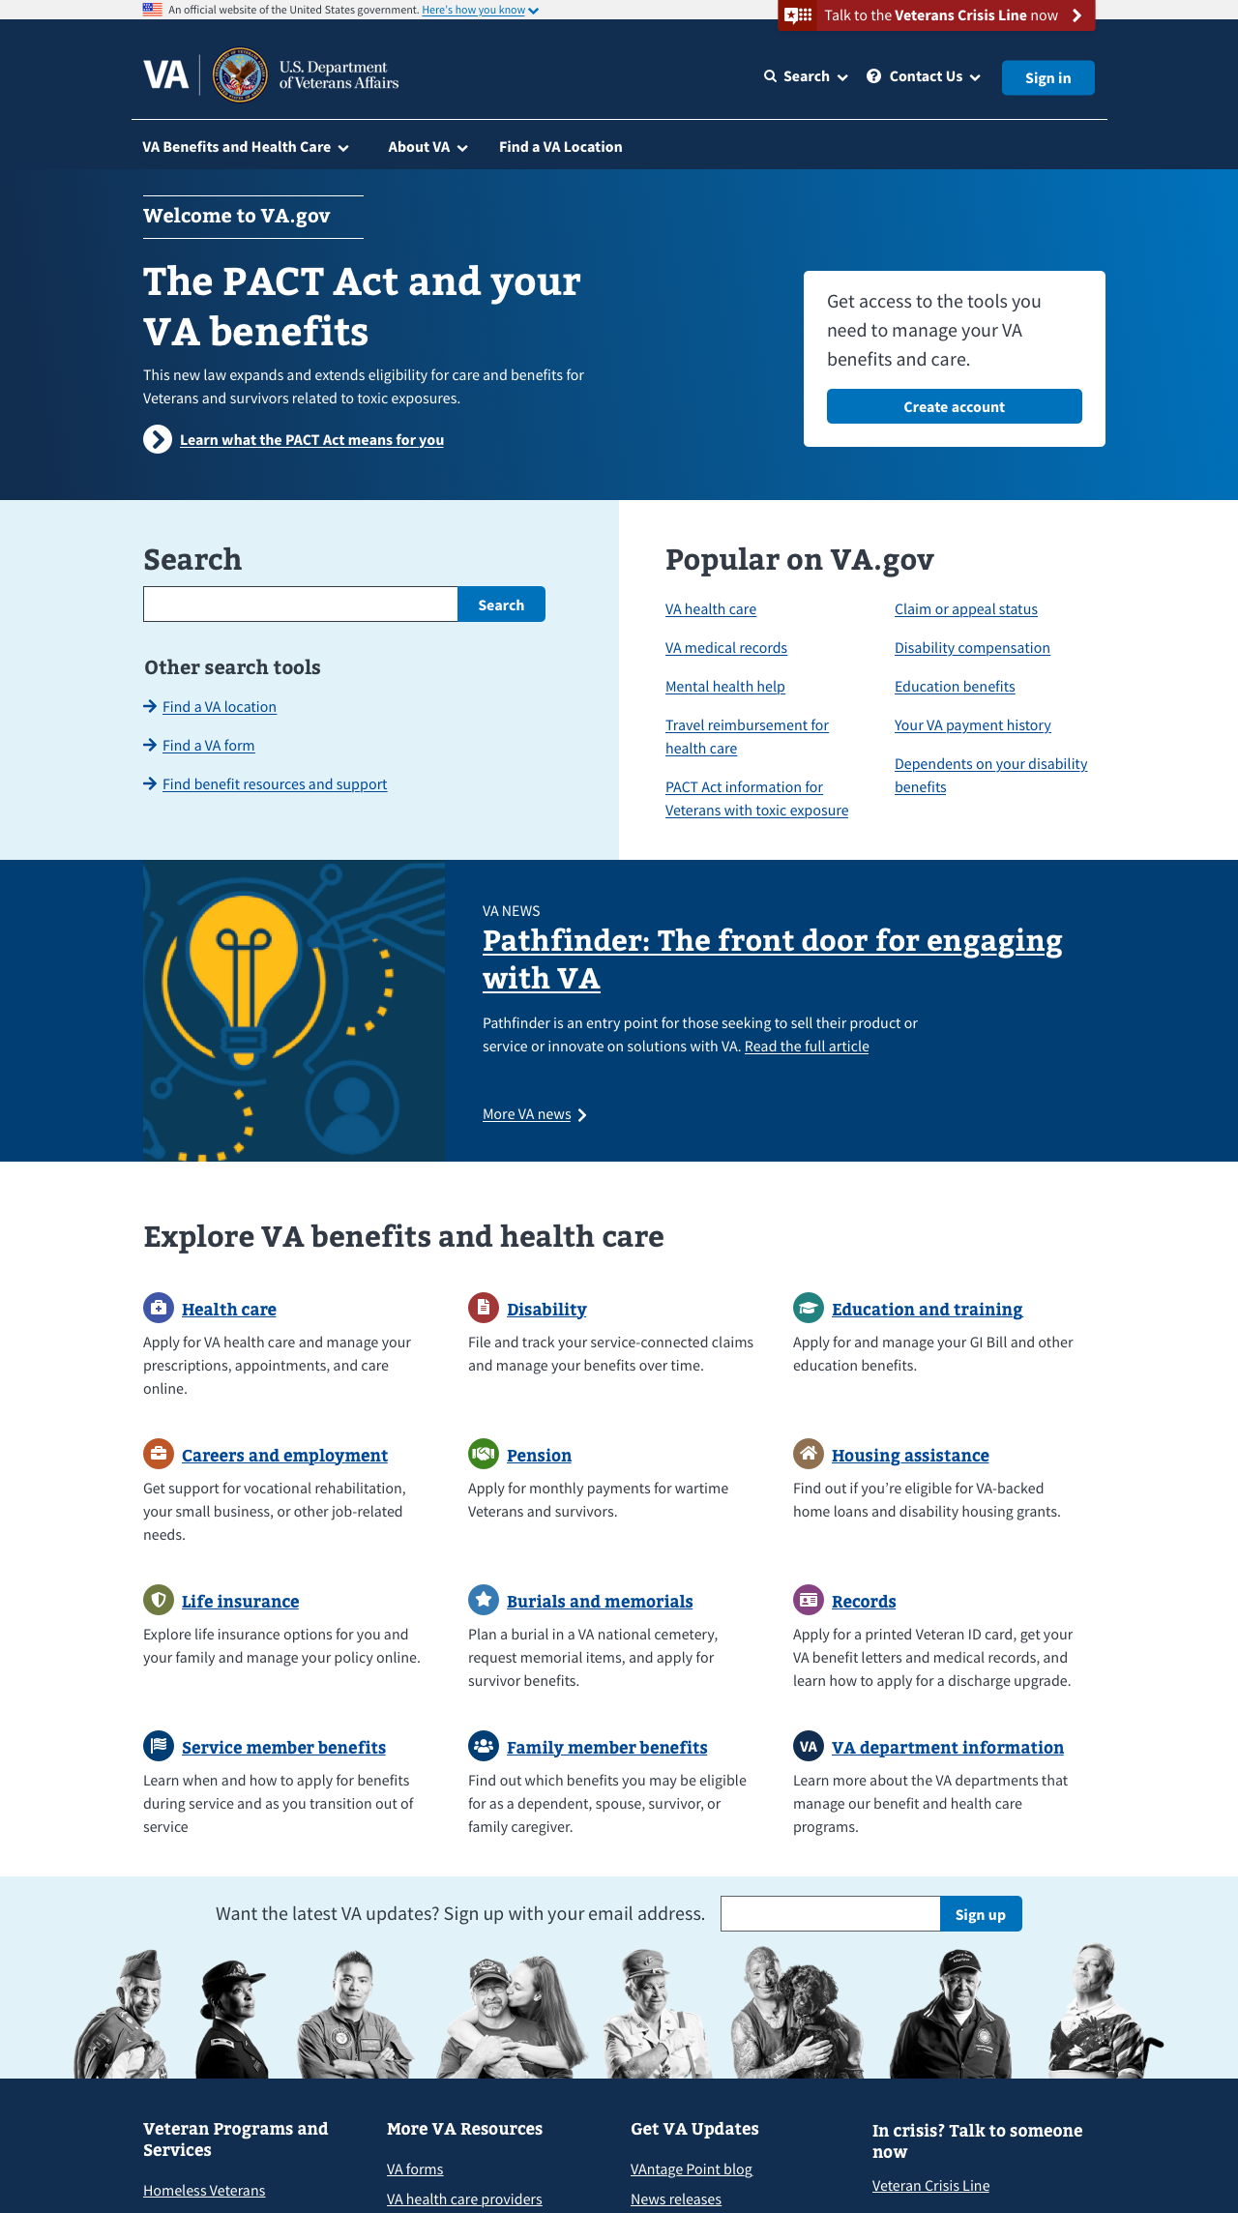
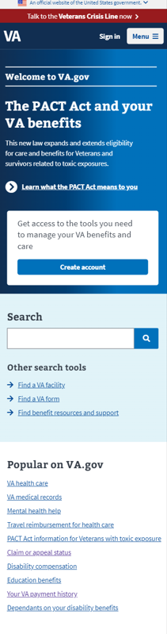
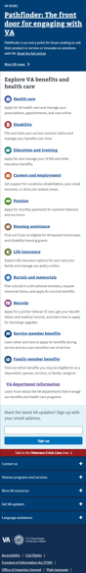
Validating with research
Homepage Refresh – Design Experiment v2
Participants who use smart phones and those who use screen readers and other assistive technology have been recruited to help us validate this design.
We hope you will join us as observers – more information on the process to come.

Slide 22
What to expect next

Slide 23
Upcoming updates
Homepage Refresh – What to Expect Next
Veteran research next week
If interested in observing one of these sessions, please respond to the meeting notes email
Access to research findings
Refinement of objectives and key results
Establishment of content governance and rubric to deliver meaningful Veteran-facing content
Design iteration, as necessary, informed by research findings
Launch
Continued work on the homepage experience including header, footer, and banners
Collaboration on continued evolution of the Authenticated Experience (my VA, Profile and Health Apartment)
Notes:
looking for DMC/WGB consensus on content governance rubric
Working group?

Slide 24
Check it out for yourself
Homepage Refresh – What to Expect Next
Link to design iteration v2 in staging
Notes:
Demo on mobile/screen share if time allows

Slide 25
Omnichannel Strategy
Presenters:
Veteran Experience Services (VES) Portfolio
Veteran Experience Office (VEO)

Slide 26
Homepage Refresh Appendix

Slide 27
Defining success
Success will be measured using key performance indicators, such as
Increased click-through rates
Decreased time on page before taking any action
Increased account creation and log-in rate from the homepage
Increased Veteran satisfaction scores
Increased subscriptions to email updates

Slide 28
Homepage research demographics April 2021-August 2022
 | Participant role | Gender | Age | Race | Devices
VA.gov Home Page Redesign Usability August 2022 | Total: 19 Veterans: 16 Family members: 2 Caregivers: 1 Service members: 2 | Male: 12 Female: 6 Trans: 1 | 25-34: 2 35-44: 4 45-54: 5 55-64: 5 65+: 3 | White: 8 Black: 10 Hispanic: 2 Biracial: 3 Native: 1 Unknown: 1 | Desktop: 12 Tablet: 4 Smart phone: 3
Veteran Top Tasks MODERATED Research June 2022 and UNMODERATED Research July 2022 | Total: 55 Veterans: 47 Family members: 13 Caregivers: 8 Service member: 3 Survivor: 1 | Male: 28 Female: 26 Unknown: 1 | 25-34: 7 35-44: 13 45-54: 12 55-64: 13 65+: 10 | White: 34 Black: 10 Hispanic: 7 Biracial: 1 Asian: 1 Native: 2 Unknown: 2
Baseline Wayfinding Research April 2021 | Total: 13 Veterans: 12 Family members: 1 Caregivers: 1 | Male: 9 Female: 3 | 55+: 6 Under 35: 1 | People of color: 4 | Desktop: 8 Tablet: 1 Smart phone: 4 Assistive Tech: 1
The sum of participants by role may exceed the total number due to overlapping roles (a Veteran who is also a caregiver, for example).
Notes:
Beneficiaries = family members, caregivers, and survivors
The number of participants to be recruited is influenced by a variety of factors, including the required degree of confidence, available resources, session duration, and the availability of the type of participants requested.

Slide 29
Findings from Veteran top task research
For example, from our most recent top task research we learned
Veterans and beneficiaries identify tasks related to health care benefits as some of their most important and frequent.
Top tasks vary by participant age and are quite different for participants who don't use VA health care.
Participants selected an average of 9.5 tasks as important.
It is challenging to recruit people who don't use VA benefits.

Slide 30
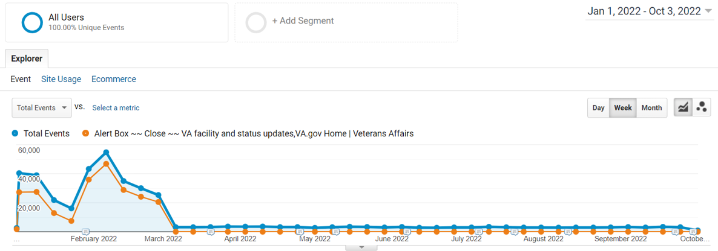
Dismissals of "facility status update" banner

Slide 31
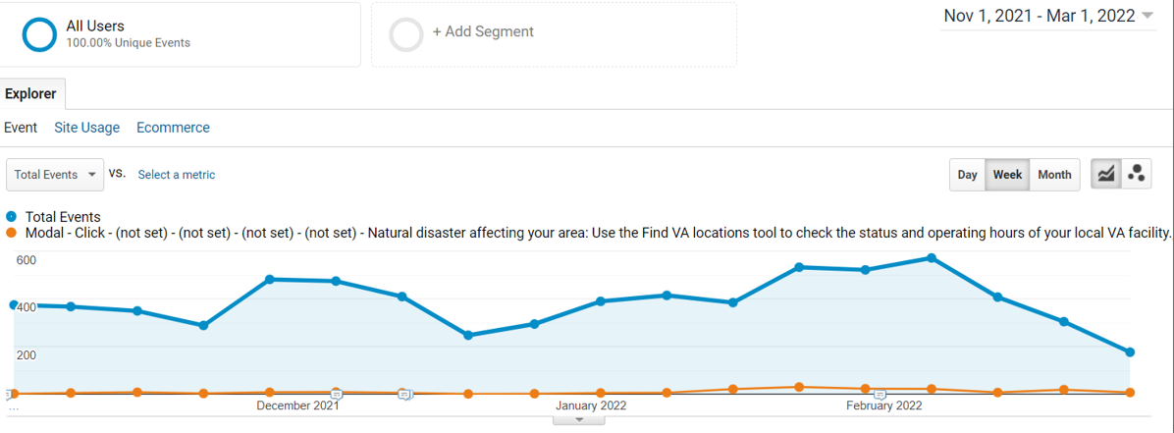
Interactions with the "Natural disaster" banner

Slide 32
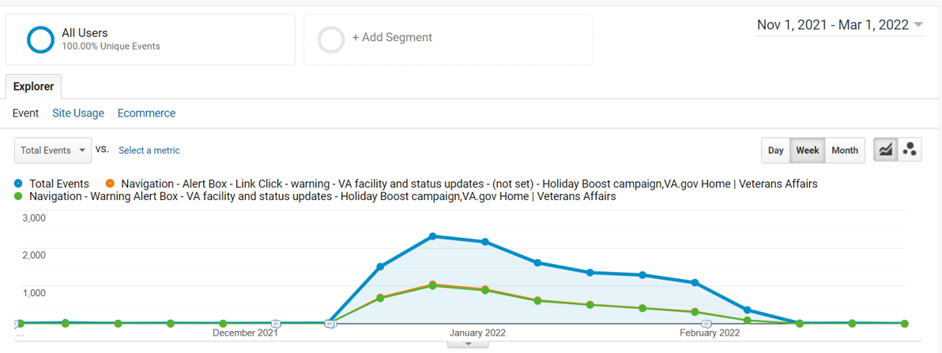
Interactions with the "Holiday boost" banner

Slide 33
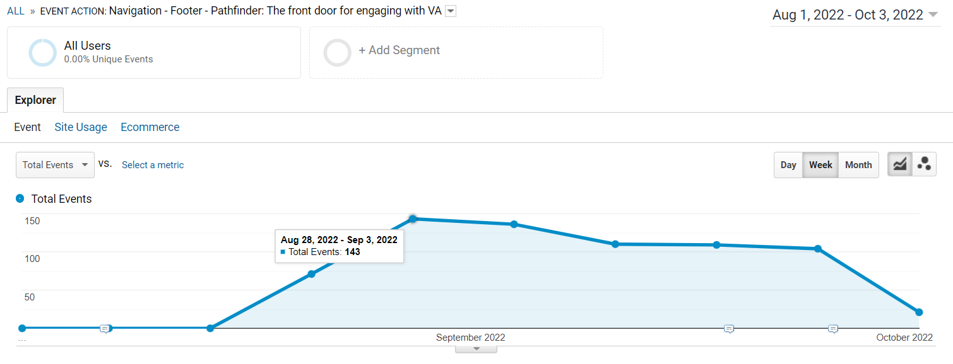
Pathfinder - interactions

Slide 34
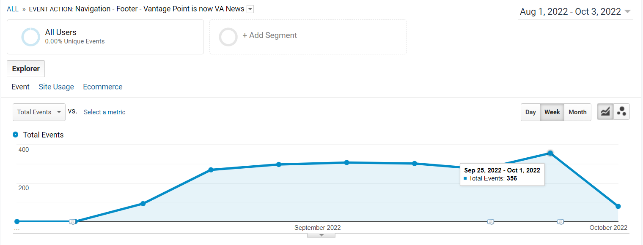
Vantage Point is now VA News - interactions

Slide 35
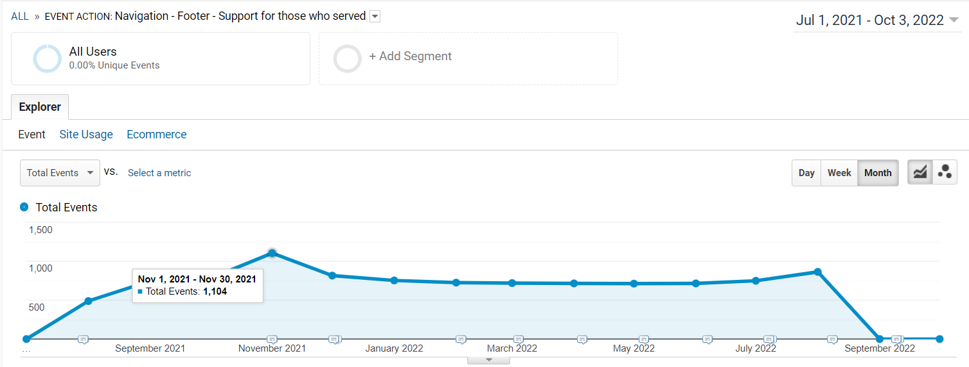
Support for those who served - interactions

